Slide 1

Café Analytics Pilot Presentation
A pilot data analytics solution analysing sales, profit, and customer behaviour using Python and Power BI
By Alexandra Sotelo

Slide 2

Methodology Overview: Tools and Workflow
Python in VS Code: data cleaning and anonymisation
Power BI: Dashboard creation and KPI design
GitHub: Version control and documentation
Raw
Ingestion
Python
cleaned_data.csv
Power Bi
By Alexandra Sotelo

Slide 3
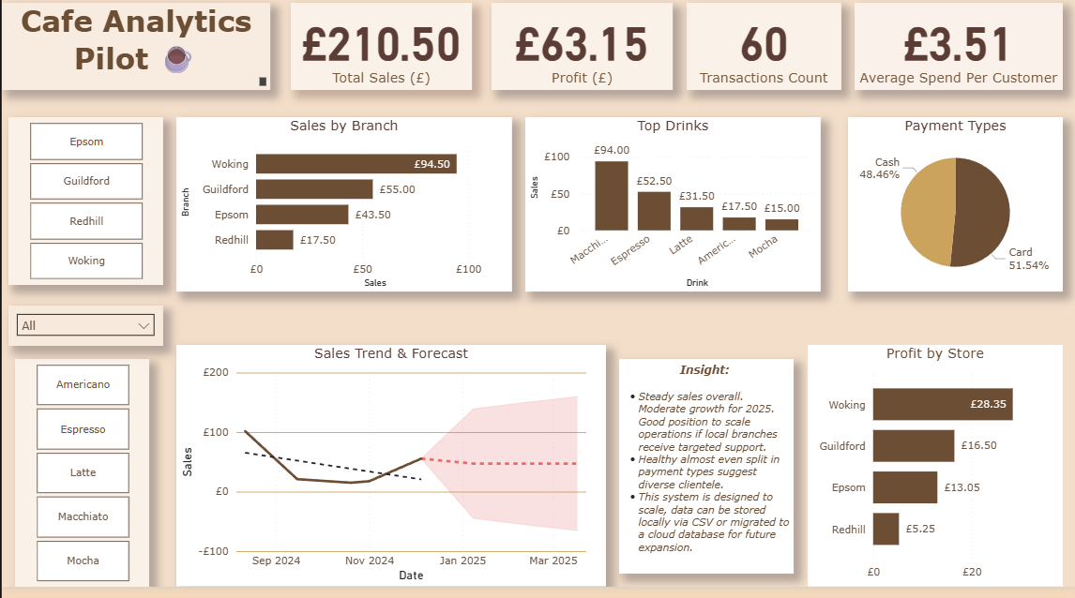
Dashboard Highlights
KPI Cards: Totals Sales, Profit, Transactions, Average Spend
Bar Chart: Sales by Branch
Column Chart: Top Drinks
Line Chart: Sales Trend with Forecast
Pie Chart: Payment Breakdown
By Alexandra Sotelo

Slide 4
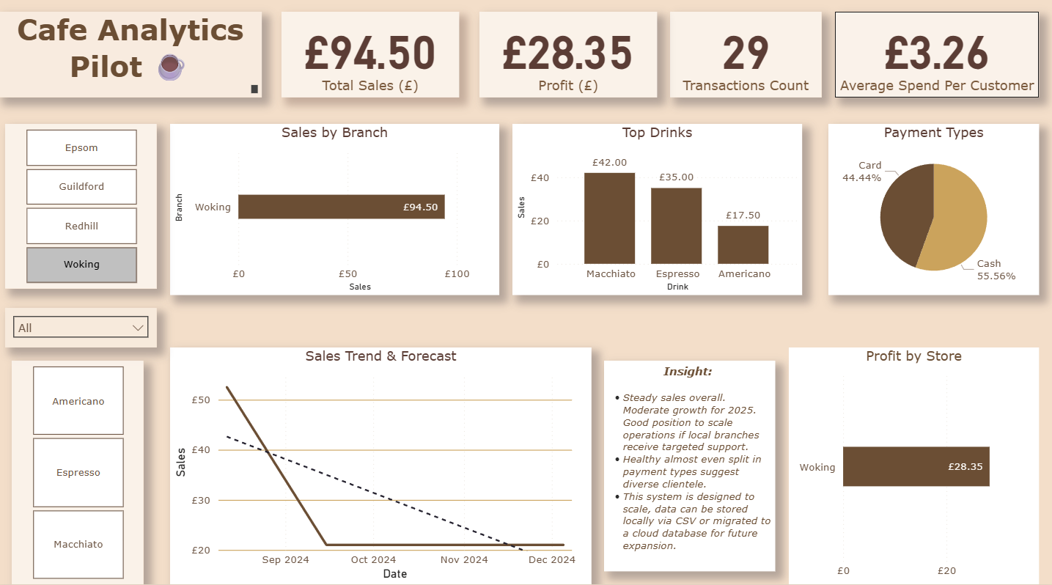
Insights and Recommendations
What the data shows
Woking branch outperforms in total sales
Macchiato is top-selling drink followed by Espresso
Card payments outnumber cash payments, but the split is almost even
Sales dip mid-year but rebound in winter
Recommendations
Introduction of loyalty cards and rewards during off-peak seasons
Promote best-seller items across weaker branches
Consider a seasonal campaign strategy
By Alexandra Sotelo

Slide 5

Project Reflection
Working solo greatly improved my confidence around product design and development.
I have also further strengthened my confidence with Power BI and Python for creating ETL.
Next steps: I plan to also do the other option of the project task and build my own automated pipeline potentially looking at connecting Power BI to SQL for dynamic refresh.
I also plan on teaching myself how to use hashlib to encrypt PII and analyse repeat customer behaviours.
By Alexandra Sotelo

